Slide 1
Front-End Developer 13 – 09.03.2018
Radovan Ostojić

Slide 2


Slide 3
Sadržaj časa
HTML
<input> types
HTML Forms - nastavak
Coding challenge
Form submission ☺

Slide 4

Ponavljanje je majka znanja ☺
<input>
Type attribute
Action attribute
Method attribute
Query string

Slide 5
HTML
Drop down lists

Slide 6
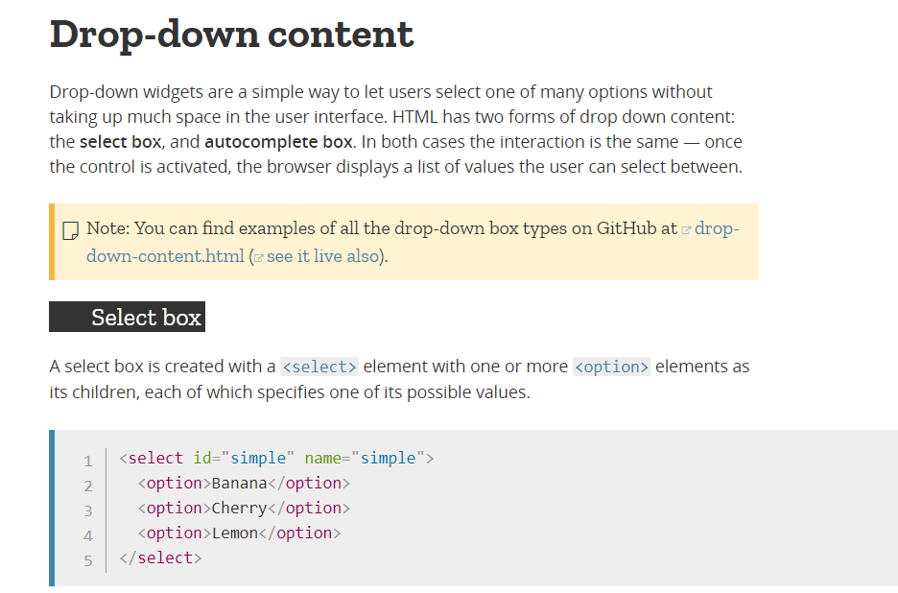

Slide 7
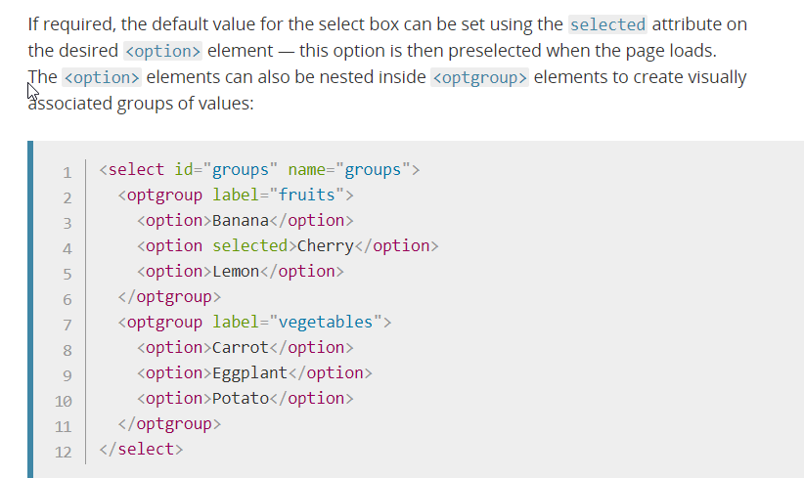

Slide 8
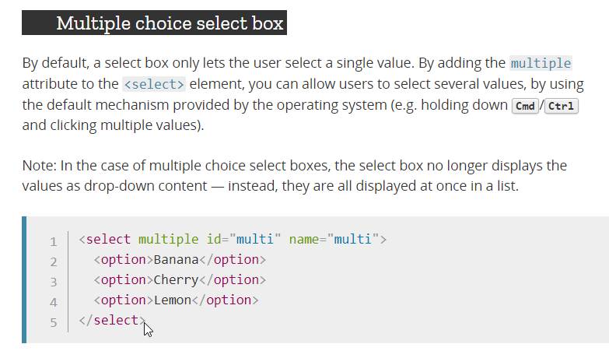

Slide 9
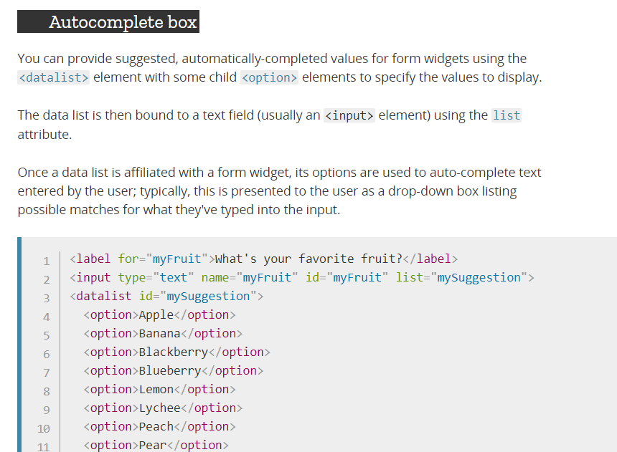
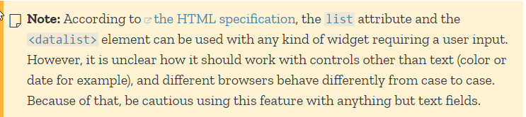

Slide 10
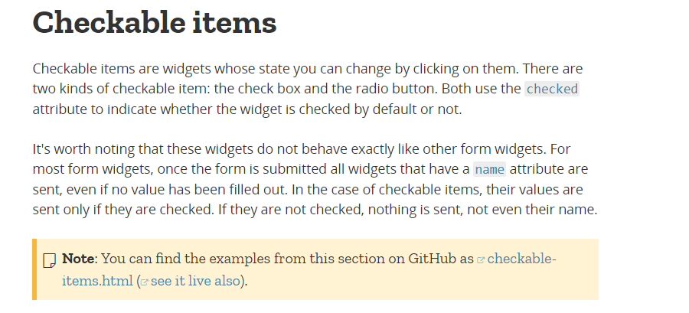

Slide 11
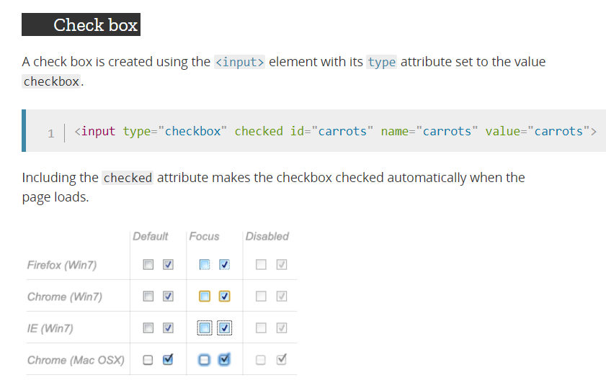

Slide 12
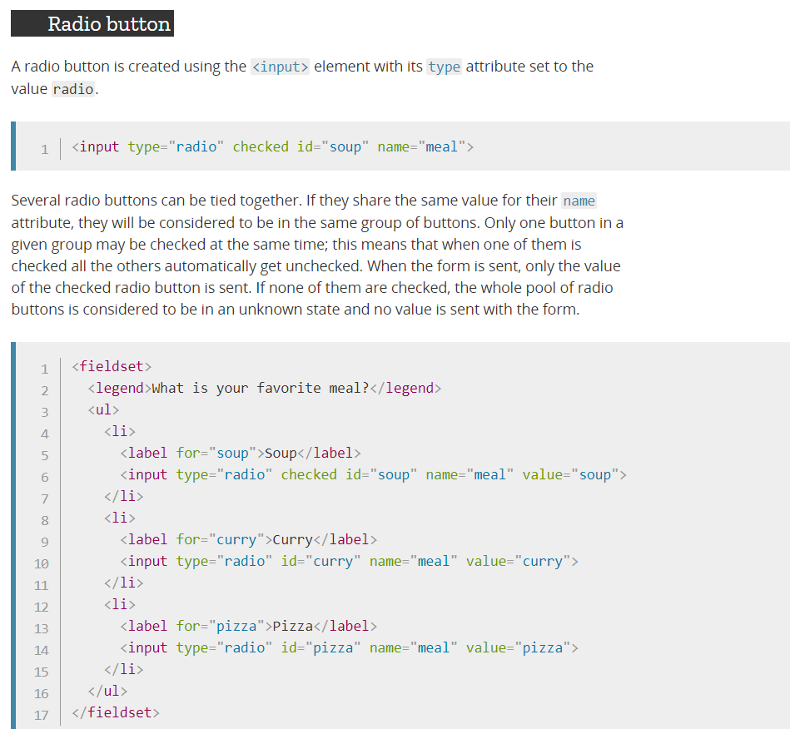

Slide 13
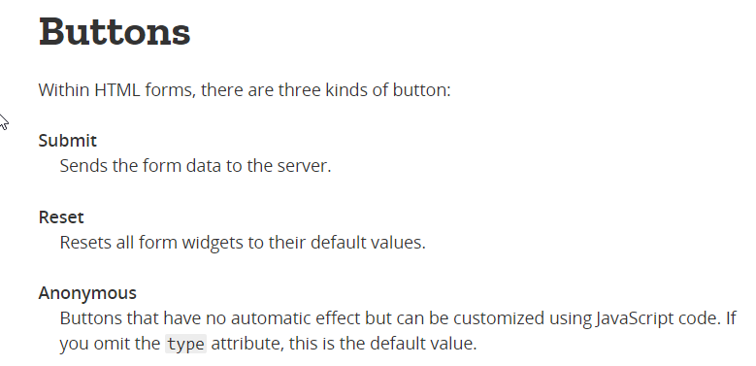

Slide 14
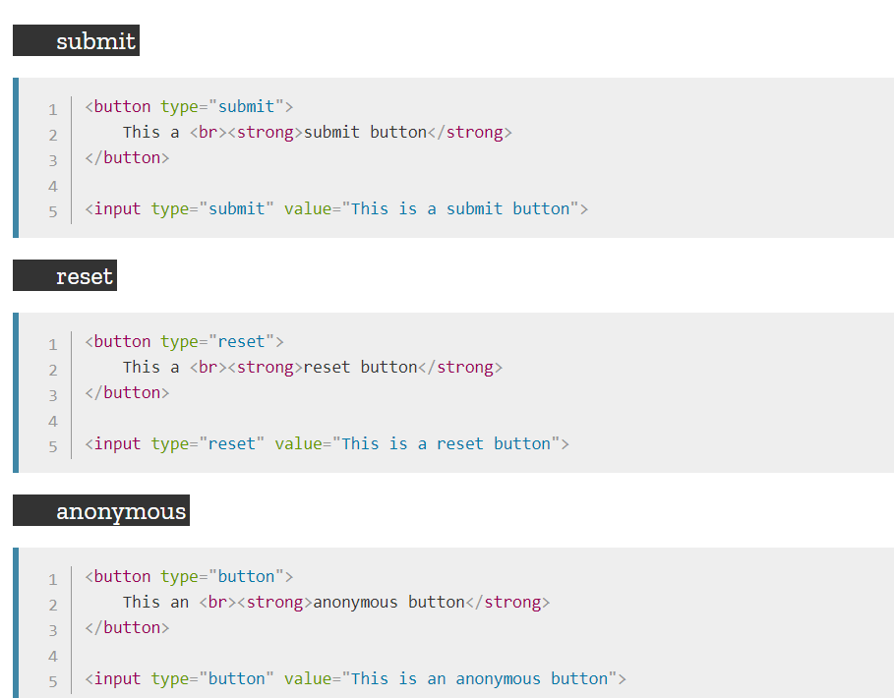

Slide 15
HTML
Advanced controls

Slide 16
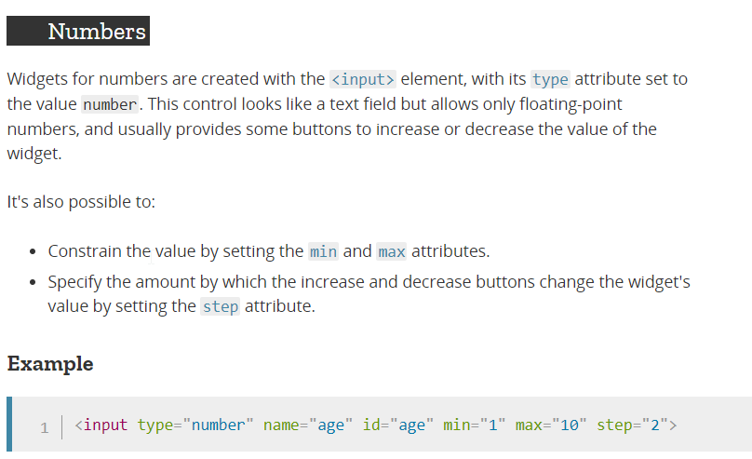

Slide 17
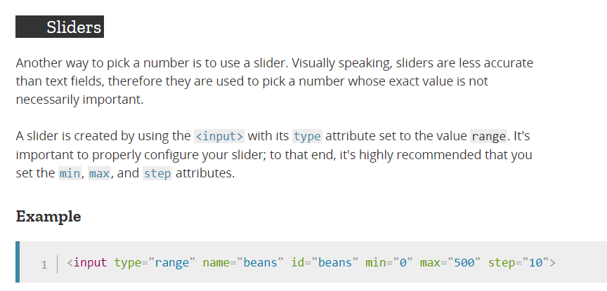

Slide 18
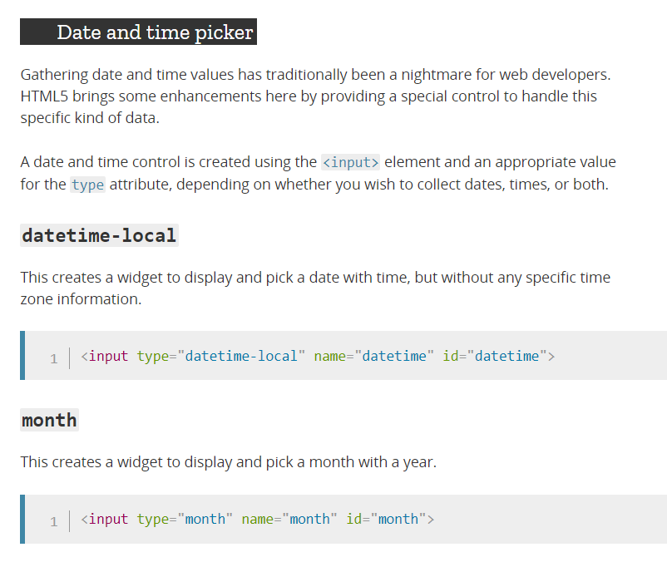

Slide 19
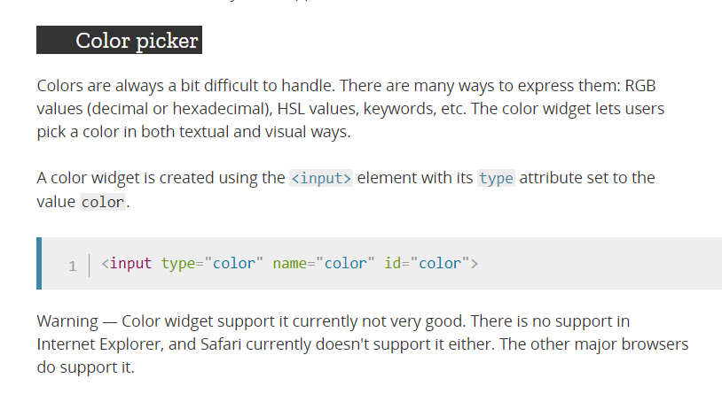

Slide 20
HTML
Styling forms

Slide 21
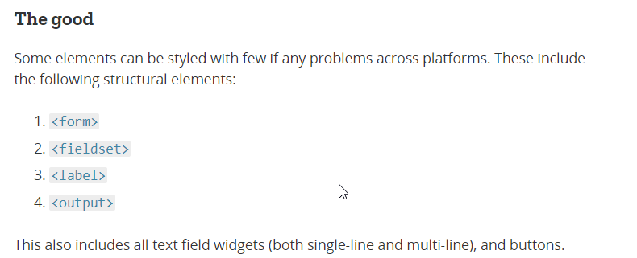

Slide 22
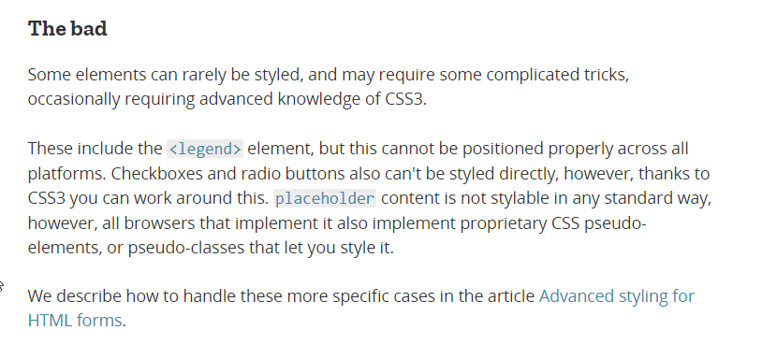

Slide 23
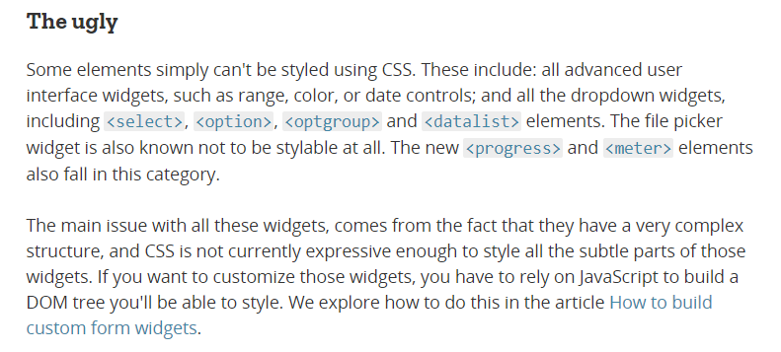

Slide 24
Coding challenge
Form submission
Igra pogadjanja brojeva

